Slide 1

Fall 2013
CSE 489: Digital Image Processing
Topic - 1: Introduction
Contents:
  What Is Image Processing?
  Applications
  Research

Slide 2
What Is Image Processing?
Digital image processing is a subject of a set of computational techniques for analyzing, enhancing, compressing, and reconstructing images.
Its main components are
  importing, in which an image is captured
  analysis and manipulation of the image
  outputting

Slide 3
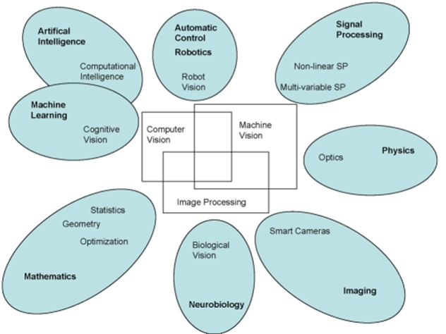
What Is Image Processing?
Relation between image processing and various other fields:

Slide 4
Applications
Digital image processing, or simply image processing, has extensive applications in many areas, including
    Astronomy
    Medicine
    Industrial robotics
    Industrial quality control
    Automatic navigation
    Remote sensing by satellites
    and so on
Notes:
786

Slide 5
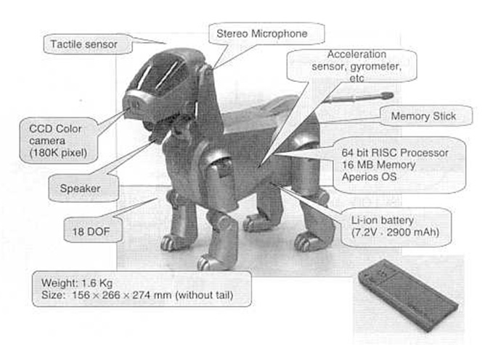
Applications
Robot dog AIBO
:

Slide 6
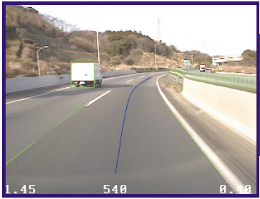
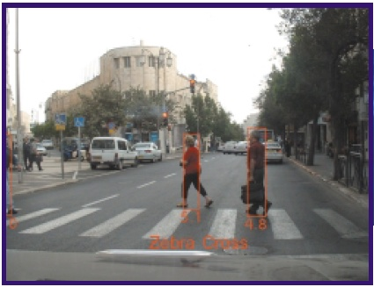
Applications
Automobile navigation
Lane departure warning
Pedestrian detection
see www.mobileye.com for more applications

Slide 7
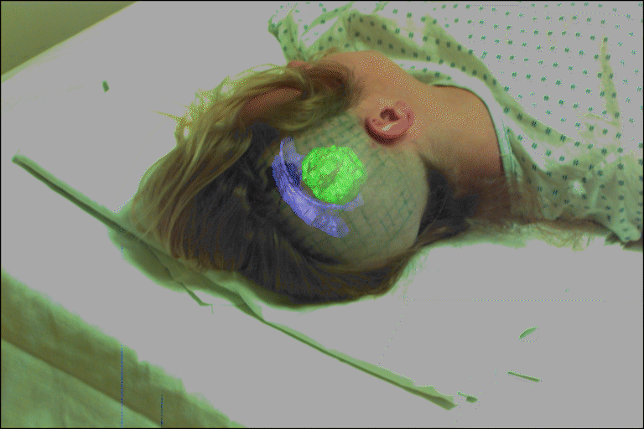
Applications
Medical augmented reality
Visually guided surgery: recognition and registration

Slide 8
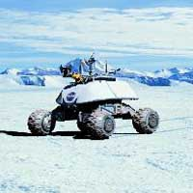
Applications
Robot for exploration
:

Slide 9
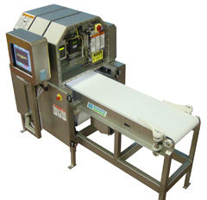
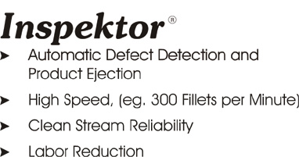


Applications
Vision based system for food product inspection:
:
<>

Slide 10
Research
Image processing is an active area of research in such diverse fields as
  Medicine
  Astronomy
  Defense
  Industrial quality control
  Publication and entertainment industries
  and so on
Notes:
786

Slide 11

Research
Vision based machine for textile defects detection
Notes:
786

Slide 12
Research
Vision challenges for textile defect detection
  Defects are non-geometric in nature
  Defects could be very small
  Defects could be similar to textile patterns
  Many more…
Notes:
786

